Slide 1
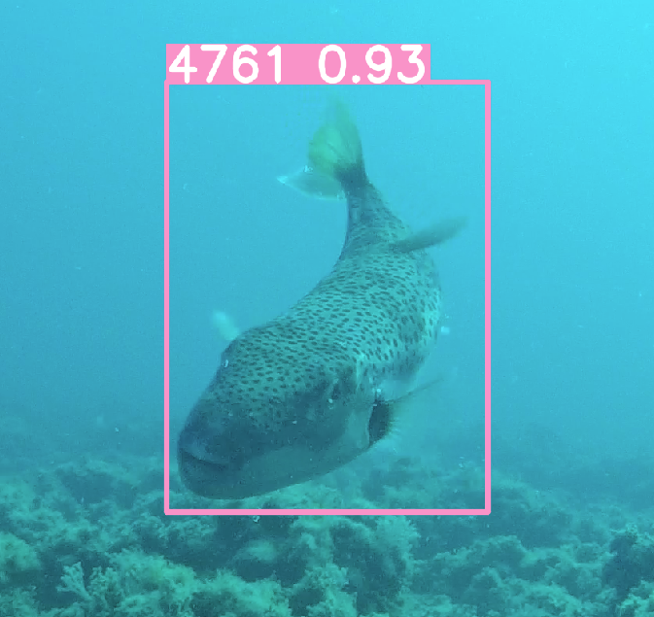
FishNet
Early warning for invasive fishes
By Inbal Power & Ron Montaoriano

Slide 2
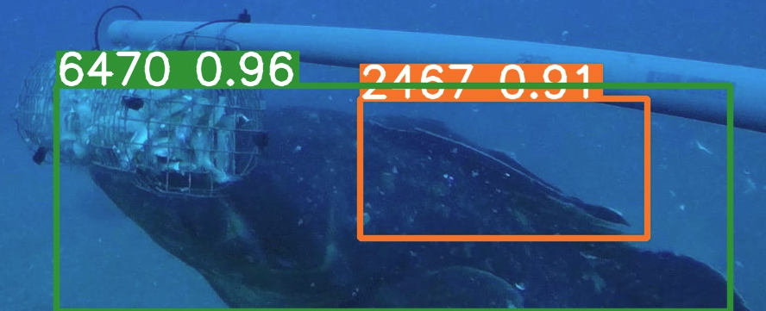
Goal!
The project aims to develop an automated system to detect invasive fish species in the Mediterranean, using manually labeled data to train and enhance image recognition capabilities, supporting ecological monitoring and management efforts.

Slide 3
Table of contents
01
02
03
04
Introduction
Why is the tool we developed important?
Data, labeling and annotations
From 20 terabytes to a balanced dataset
Modeling
Comparison of model size, hyperparameters and inputs
Results and conclusions
How many types and how well we were able to identify

Slide 4
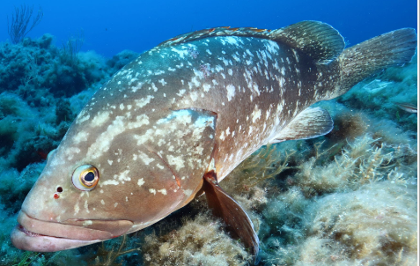
01
Introduction
Epinephelus marginatus - 6470
Threat of Invasive Species
Need for Early Detection
Role of Technology in Conservation

Slide 5
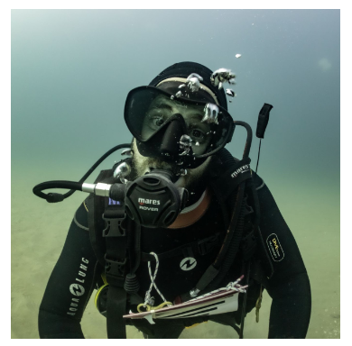
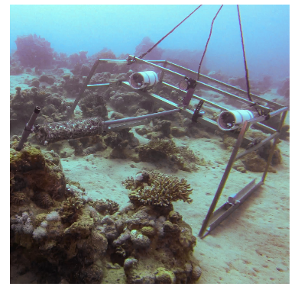
02
Preprocessing
Data collection by the Belmakar lab
Shahar Chaikin - PhD students
The photography system - two Go Pro 5 cameras and a 1.5 meter long rod with bait

Slide 6
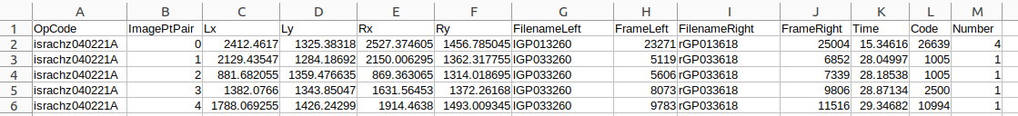

02
Preprocessing
2022-0509_med_campaign_stereoBRUVs_3DPoints
2022-0509_med_campaign_stereoBRUVs_ImagePtPair
2022-0509_med_campaign_stereoBRUVs_Lengths
Fish tagging using coordinates and classification.
Finding the main frames and labeling them (~ 7 GB)
Using the roboflow application for manual labeling to improve the learning of the model.

Slide 7
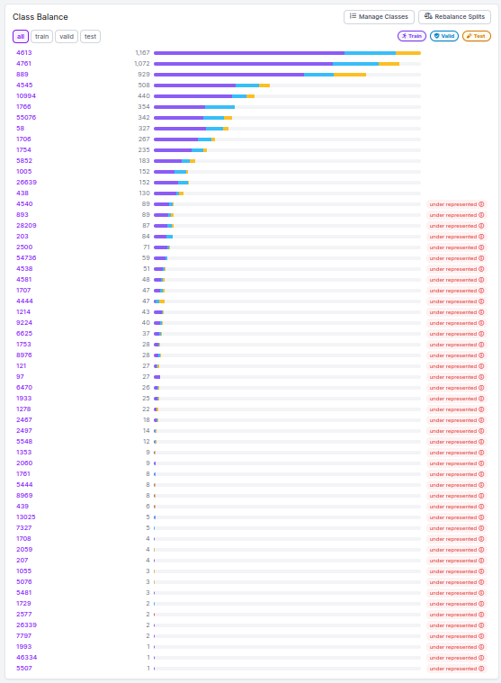
02
Preprocessing
Receiving a very unbalanced dataset
Creating augmentations for the “rare” species
Flip )Horizontal & Vertical(
90° Rotate
Contrast
Brightness
sharpness
Splitting ratio
Train 70%
Val 15%
Test 15%

Slide 8




03
Modeling - Which model to choose?
VGG - 16
ResNet - 50
SSD300
YOLOv8

Slide 9
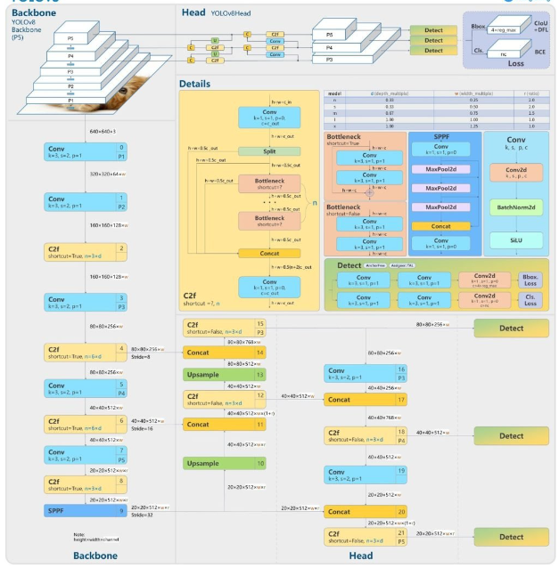
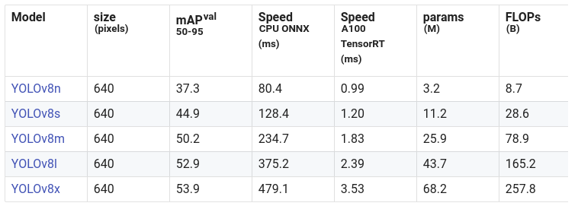
03
Modeling - Which model size to choose?

Slide 10
03
Modeling - optimizer
 | SGD | Adam | AdamW
Small | 0.835/0.815/0.883/0.538 | 0.646/0.537/0.599/0.32 | 0.7/0.53/0.613/0.337
Medium | 0.86/0.814/0.899/0.591 | 0.618/0.51/0.578/0.309 | 0.687/0.523/0.601/0.329
Large | 0.904/0.854/0.939/0.643 | 0.686/0.473/0.57/0.307 | 0.699/0.573/0.665/0.382
The order of the values in the table is: Percision/recall/mAP95/mAP50

Slide 11
03
Modeling - dropout
 | 10% | 20% | 30%
Small | 0.887/0.884/0.948/0.638 | 0.887/0.884/0.948/0.638 | 0.887/0.884/0.948/0.638
Medium | 0.912/0.921/0.965/0.702 | 0.912/0.921/0.965/0.702 | 0.912/0.921/0.965/0.702
Large | 0.92/0.934/0.967/0.737 | 0.92/0.934/0.967/0.737 | 0.92/0.934/0.967/0.737
The order of the values in the table is: Percision/recall/mAP95/mAP50

Slide 12
03
Modeling - Freezing layers
 | 10% | 15% | 20%
Small | 0.898/0.91/0.958/0.673 | 0.88/0.895/0.954/0.654 | 0.895/0.892/0.951/0.65
Medium | 0.939/0.931/0.971/0.734 | 0.93/0.941/0.968/0.716 | 0.929/0.929/0.966/0.707
Large | 0.941/0.947/0.978/0.779 | 0.947/0.941/0.974/0.765 | 0.947/0.932/0.971/0.749
The order of the values in the table is: Percision/recall/mAP95/mAP50

Slide 13
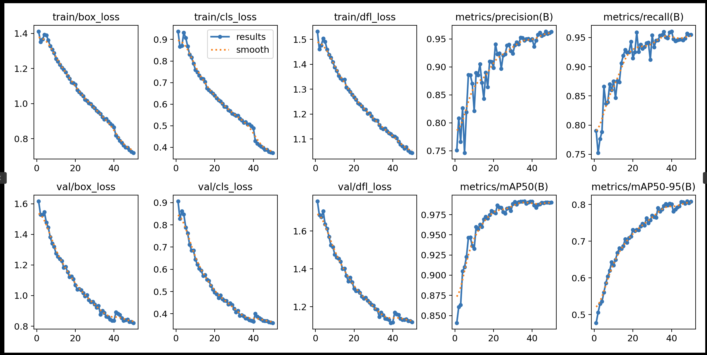
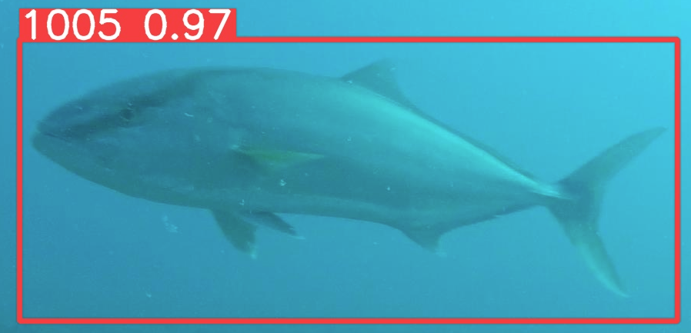
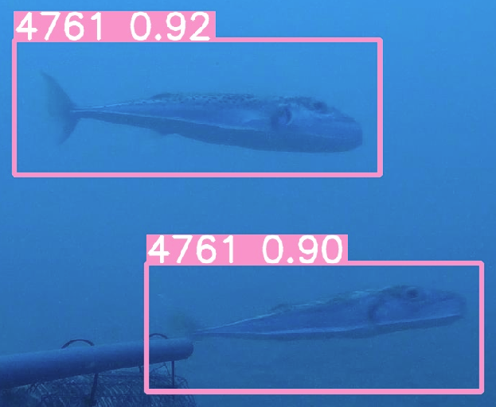
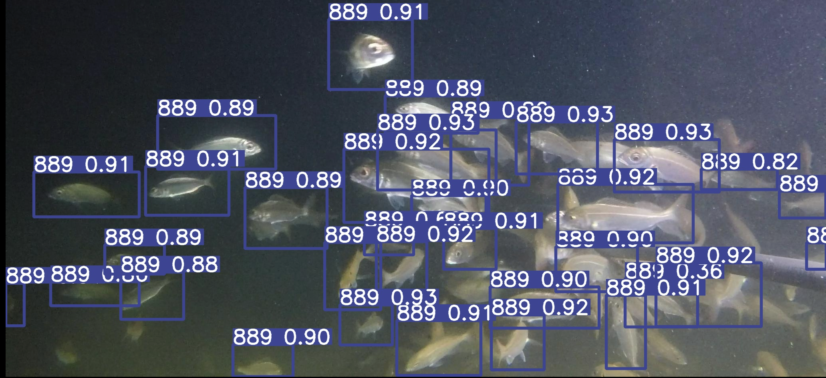
04
Results
0.718
1.044
0.374
0.963
0.954
0.821
0.358
1.119
0.99
0.808

Slide 14
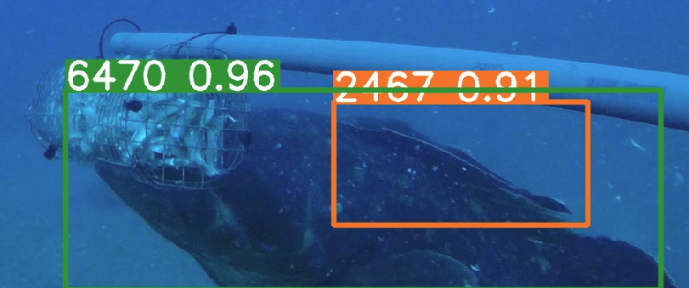
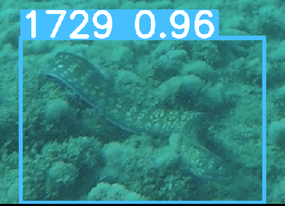
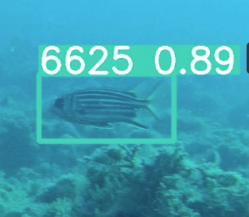
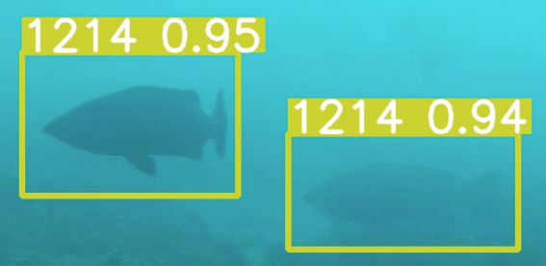
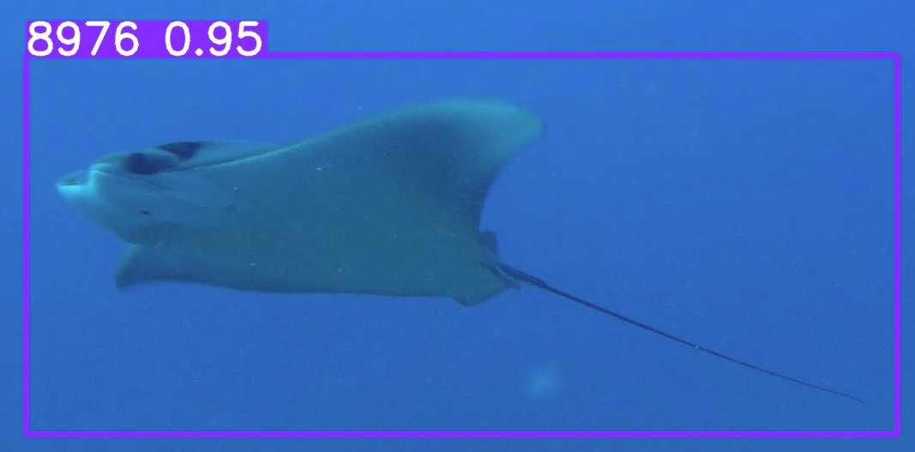
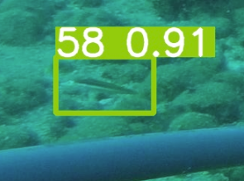
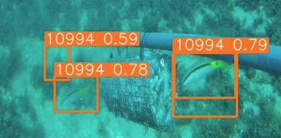
04
Results - rare

Slide 15
04
Conclusions
Dataset Enhancement - Addressed the challenges of an unbalanced dataset through increased data collection, meticulous labeling, and targeted model fine-tuning.
Successful Identification - Achieved comprehensive identification of all requested fish species, showcasing the model's effectiveness in real-world applications.
Implications and Future Directions - The project's success supports essential marine conservation efforts and paves the way for next-generation ecological monitoring technologies.

